Slide 1
Spam or Ham Detection
Varun Murthy Mokarala
CSU ID:2756232

Slide 2
Introduction
What is spam?
Spam also called as Unsolicited Commercial Email(UCE)
Involves sending messages by email to numerous recipients at the same time (Mass Emailing).
Grew exponentially since 1990 but has leveled off recently and is no longer growing exponentially.
80% of all spam is sent by less than 200 spammers.

Slide 3
Problem Statement
Unwanted e-mails irritating internet connection
Critical e-mail message are missed and/or delayed
Taking a dataset that contains spam and ham messages
Analyze the dataset and collect the most used words in the spam messages and ham messages.
Differentiating the words by spam and ham.

Slide 4
Description of Dataset
Ham | Spam
4849 | 725
87% | 13%
It contains set of SMS messages in English of 5,574 messages, tagged according being ham (legitimate) or spam.
https://archive.ics.uci.edu/ml/datasets/SMS+Spam+Collection

Slide 5
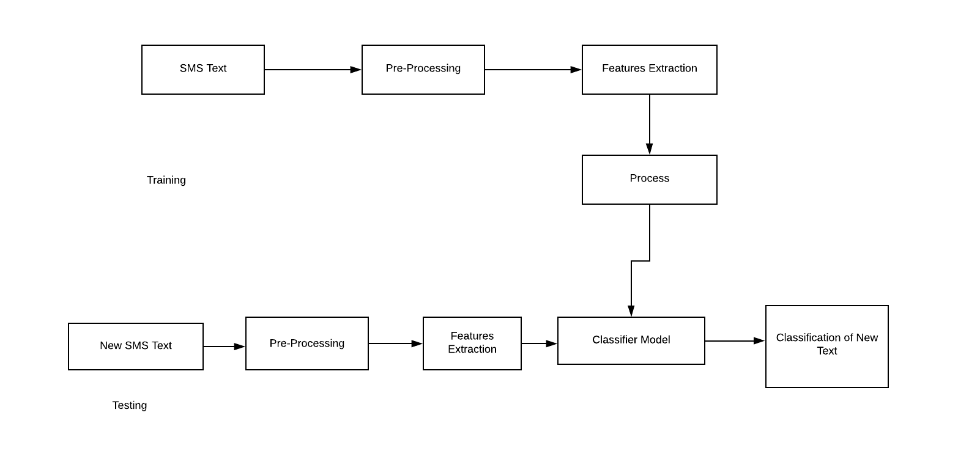

Slide 6
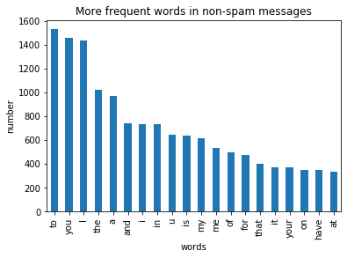

Slide 7
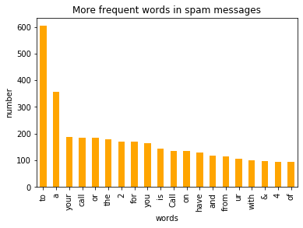

Slide 8
Classification Algorithm(Naive Bayes)
We train different bayes models changing the regularizations parameter alpha.
Confusion matrix with naive bayes classifier
 | Predicted 0 | Predicted 1
Actual 0 | 1587 | 0
Actual 1 | 56 | 196

Slide 9
Classification Algorithm(Support Vector Machines)
We are going to apply the same reasoning applying the support vector machine model.
We train different models changing the regularization parameter C.
Confusion matrix for support vector machine classifier
 | Predicted 0 | Predicted 1
Actual 0 | 1587 | 0
Actual 1 | 31 | 221

Slide 10

Performance Measure
Accuracy = $\frac{\text{True} \text{Positive}\text{ + }\text{True} \text{Negetive}}{\text{Total} \text{Number} \text{of} \text{Test} \text{Data}}$

Slide 11
results of different classifiers
MODEL | Accuracy%
NB | 96.7%
SVM | 98.3%

Slide 12
Conclusion
The best model I have found is support vector machine with 98.3% accuracy.

Slide 13
THANK YOU

